Slide 1

How to Choose Software
A process to select I.T. solutions
Mantos I.T. Consulting
Rev: 22-Apr-2013

Slide 2
Some Concepts Used
Capability (a definition from Merriam-Webster)
  The facility or potential for an indicated use or deployment
  E.G. Billing; Transcription; Warehousing; Payroll
Requirements –
  Needs to do XXX, possibly in a given way meeting constraints;
  The capability to bill requires time entry
Constraints –
  “Hard” requirements that must be met
  Must integrate with QuickBooks & cost less than $25K
Functions – What the software does (and does not do)
Features – How requirements are met
  Time cards are entered using smart phones

Slide 3
The Goal of the Process
Ensure that all I.T. capabilities are “covered”
Capabilities generally covered using “solution”
An I.T. solution uses hardware or software
Generally, 1 capability is covered by 1 solution
  However, a software package may cover more
  Or, >1 software packages needed for 1 capability
Goal is to pick solutions (software) to cover all or most of the most important capabilities.

Slide 4
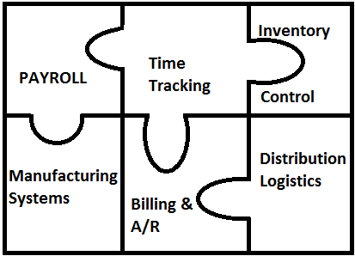
Example Capabilities to be covered

Slide 5
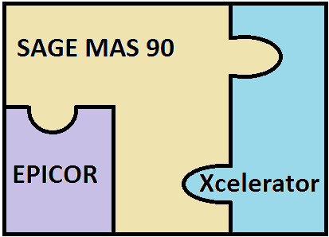
Example solution set that would cover capabilities

Slide 6
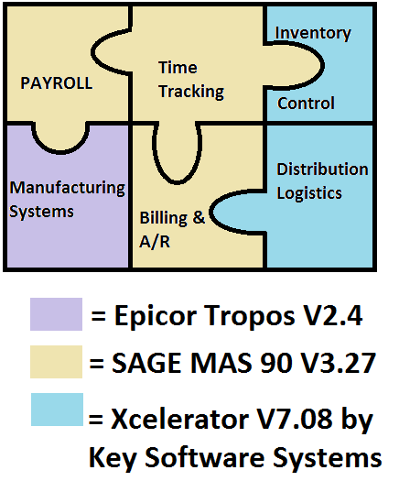
Example Covered Capabilities

Slide 7
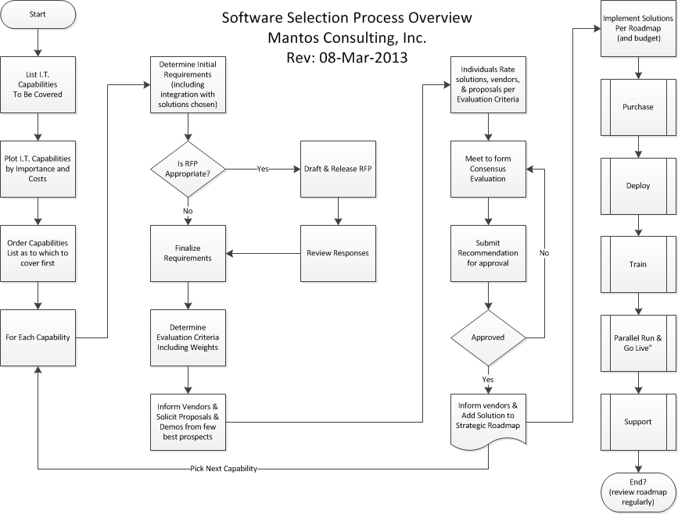

Slide 8
Capabilities:
Critical Functions of Business
List them
  Start with existing (take an automated inventory)
  Add missing & drop unnecessary capabilities
  E.G., Work Flow; Accounting; Legal Research; Document Management; E-File; Calendaring
Categorize them
  E.g.; Front Office and Back office
Plot them
  Core versus Peripheral
  Expensive versus Cheap

Slide 9
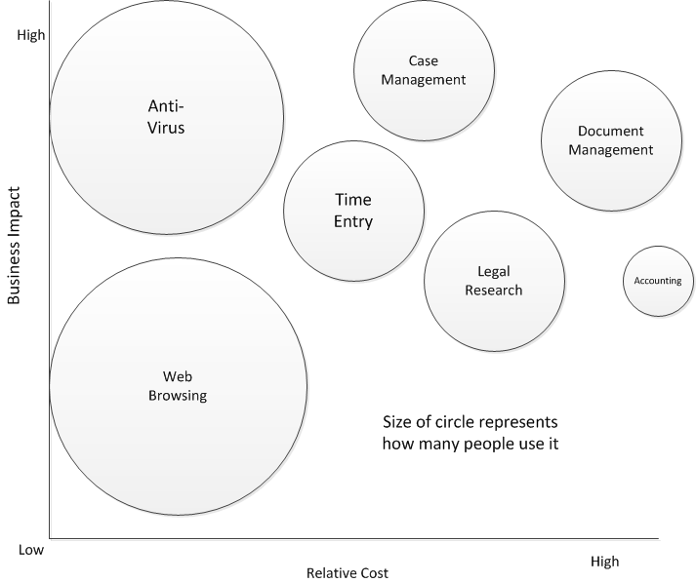
Example Capability Plot

Slide 10
Start with most important, high cost capabilities
Identify “core” capabilities
  Most important,
  Likely high cost
  NOT a “commodity” item (relatively few choices)
Start software selection process for THAT one capability (or VERY few of them)
Select other capabilities to address AFTER selecting solutions for core capabilities
E.G., Law Firm’s “core” = “Case Management”

Slide 11
A Tradeoff : selecting one program or a suite
Requirement of most programs is that it “plays well with others” (integrates)
Easiest methodology is:
  focus on one capability at a time
  “require” new software integrates with existing
Method could lead to sub-optimal integration
Possible that “Next” choice would have been different if capabilities were looked at together, or in a different order
“Optimal” is traded for method to pick “Good”

Slide 12
List Requirements for that Capability
Research most popular (well-supported) packages
Look for functions and features that some/all share
Note features that may be unique to some
Rank / Weigh requirements
  “must haves” versus “bells and whistles” (see spreadsheet)
Determine evaluation criteria BEFORE demonstrations
Possibly develop RFP (depending upon complexity / cost)
Evaluate Responses (individually, then collectively)
Solicit Demonstrations & Proposals from FEW vendors
Rate packages per criteria (functions, features, costs, support, ability to integrate, training, etc.)

Slide 13
Example Functional Requirements
(Specific to capability)
Legal Research
  Included or not
  Integrated with product or not
Billing
  Time capture
  Integrates with QuickBooks (A/R)
Tiered Pricing
New Mexico E-Docket compatible

Slide 14
Commercial Off-the-Shelf Software
(COTS)
Strategies differ between business
  So Stratity™ devotes time to “business discovery”
Often Small Biz strategy calls for using COTS
  Relatively cheap vis-a-vis custom development
  Well tested (1,00’s or 1,000’s of users)
  Typically integrates well with other popular COTS
  Well supported by vendors, wiki’s, YouTube, etc.
If a COTS meets most requirements, BUY IT!

Slide 15
Example Generic requirements
Vendor – Due Diligence
  Years that vendor has been in business
  Installed user base
  Source code is in Escrow
Training
  Requires less than X hrs and $Y per person
Architecture
  Runs on specific version of Operating System
Fixed costs versus variable
  Price per server versus Price per user
  Price at installation versus Price per year
One-time costs ongoing (support, maintenance)

Slide 16
Do you need a
“Request for Proposal”
The more complicated, important, expensive a solution; the more thorough you need to be
RFP documents what you are trying to solve
Includes your initial requirements
Specifies response format and response dates
May include initial evaluation criteria
May allow for vendor Questions and Answers
Takes time and money to draft & evaluate RFP

Slide 17
Finalize Requirements
& Evaluation Criteria
Based on responses from potential vendors, you may learn of more pitfalls or features
Revise Requirements based on new info
Determine which are “hard” or “soft”
(Collectively) determine how important each
  The “weight” of each response
  See sample evaluation matrix
Agree how , not who, winner will determined

Slide 18
Meet to Fill Out Left Side of
Software Evaluation Sheet
Capability | Function | Feature | Evaluation Criteria | Weight
Case Management | Legal Research | Integration | Supports LexisNexus and/or WesLaw | 10
 | Legal Research | Content | Regs; Periodicals; 5= All | 5
 | Legal Research | Clarity | Easy to use; Navigate; See | 5
 | Legal Research | Timeliness | 5 = 24 hours; 4=1 week; 3 = Month | 5
 | Legal Research | Coverage - Jurisdiction | 5 = Fed & State; 4= fed; 3=State | 2
 | Legal Research | Coverage - Time | 5 = 50+ Years; 3= 5 Years | 3
 | Legal Research | Reliability | 5 = Full Citation; 3 = Hyperlinks | 3
 | Time and Billing | Time Entry |  | 5
 | Time and Billing | Mobile Time Entry |  | 2
 | Time and Billing | Approval by Manager |  | 1
 | Time and Billing | Integrates with QuickBooks |  | 2
 | Price |  | 5 <= $10K; 4 <= $25K; 3 <= $100K | 30
 | Training | Availability |  | 5
 |  | Quality | Per customer reviews (rank 1-4) | 5
Total Score | Total Score |  |  | 83

Slide 19
Invite (few) vendors for Demonstrations and/or Proposals
Whether RFP was issued or potential vendors discovered through Internet, trade shows, etc.
Determine which are most promising
Invite just top few prospects for demo
Close the door to others (exception criteria)
  Decide BEFORE closing, if door would be opened again, and under what circumstances
After demos, invite some to submit proposals

Slide 20
Sample Evaluation Scorecard
Capability: Case Management
Function | Feature | Evaluation Criteria | Weight | Vendor 1 |  |  |  |  |  | Vendor 2 |  |  | Vendor 3
 |  |  |  | Solution 1-1 |  |  | Solution 1-2 |  |  | Solution 2 |  |  | Solution 3
 |  |  |  | Notes | Score | Weighted Score | Notes | Score | Weighted Score | Notes | Score | Weighted Score | Notes | Score | Weighted Score
Legal Research | Integration | Supports LexisNexus and/or WesLaw | 10 | Subscription | 3 | 30 | Integrated | 5 | 50 | VersusLaw | 0 | 0 | N/A | 0 | 0
Legal Research | Content | Regs; Periodicals; 5= All | 5 | Regs Only | 3 | 15 | All | 5 | 25 |  | 4 | 20 | N/A | 0 | 0
Legal Research | Clarity | Easy to use; Navigate; See | 5 |  | 4 | 20 |  | 4 | 20 |  | 5 | 25 | N/A | 0 | 0
Legal Research | Timeliness | 5 = 24 hours; 4=1 week; 3 = Month | 5 |  | 4 | 20 |  | 4 | 20 |  | 3 | 15 | N/A | 0 | 0
Legal Research | Coverage - Jurisdiction | 5 = Fed & State; 4= fed; 3=State | 2 |  | 5 | 10 |  | 5 | 10 |  | 5 | 10 | N/A | 0 | 0
Legal Research | Coverage - Time | 5 = 50+ Years; 3= 5 Years | 3 |  | 3 | 9 |  | 5 | 15 |  | 4 | 12 | N/A | 0 | 0
Legal Research | Reliability | 5 = Full Citation; 3 = Hyperlinks | 3 |  | 3 | 9 |  | 5 | 15 |  | 3 | 9 | N/A | 0 | 0
Time and Billing | Time Entry |  | 5 | Imports | 2 | 10 | Direct | 5 | 25 | Yes | 5 | 25 | Yes | 5 | 25
Time and Billing | Mobile Time Entry |  | 2 | No | 0 | 0 | Yes | 5 | 10 | No | 0 | 0 | No | 0 | 0
Time and Billing | Approval by Manager |  | 1 | No | 0 | 0 | No | 0 | 0 | Yes | 5 | 5 | No | 5 | 5
Time and Billing | Integrates with QuickBooks |  | 2 | Spreadsheet | 3 | 6 | Yes | 5 | 10 | No, Sage | 0 | 0 | Yes | 5 | 10
Price |  | 5 <= $10K; 4 <= $25K; 3 <= $100K | 30 | $5K | 5 | 150 | $85K | 3 | 90 | $10K | 5 | 150 | $13K | 4 | 120
Training | Availbility |  | 5 | Online | 3 | 15 | InHouse | 5 | 25 | At Vendor | 2 | 10 | N/A | 0 | 0
 | Quality | Per customer reviews (rank 1-4) | 5 |  | 2 | 10 |  | 4 | 20 |  | 3 | 15 |  | 1 | 5
Total Score |  |  |  |  |  | 304 |  |  | 335 |  |  | 296 |  |  | 165

Slide 21
Fill in Evaluation Sheets
Three Columns for each alternative
  Notes:
    Short note to help remember why you gave that score
  Score :
    Use predetermined evaluation criteria
    Could be a simple ranking 1,2,3,4 – Higher being better
  Weighted Score (computed as Weight * Score)
Go through individually (don’t prejudice others)
Meet to develop consensus, not average, score

Slide 22
Make Recommendation
Does the evaluation team have enough info?
All agree that process was at least “good”?
Confident that high scorer is the “winner”?
If not, consider changing rules ex-post facto
  Generally NOT a good idea, but …
  Process should lead to BEST decision
If yes, then recommend solution be approved

Slide 23
Approval
Approval Process should have been decided
Present summary (one page) recommendation
  Why was decision made
  Key deciding factors
  “Next Best” alternative
Cost and Timing for implementation
  Evaluation committee recommends
  Approval committee commits resources (or not)

Slide 24
Change Strategic Roadmap & Implement
Decide when “old” solution will be phased out
Decide when “new” will come on board
Appoint “champion” who will make sure solution is implemented
Consider Formal Project Management
  Stakeholders, Scope, Prep work, Deliverables, Schedule, Resources, Budget, Training, Support, …
Celebrate successful implementation

Slide 25
Sample Strategic Roadmap

Slide 26

Questions?
Need Help?
Call Mantos I.T. Consulting, Inc.
(505) 291- 1047
sales@mantos.com
www.mantos.com
We can help:
  Stratity™ (Aligns I.T. with business objectives)
  Facilitation of Software Selection
  RFP development & Vendor management
  Project Management to Implement Solutions

